Slide 1
Command Design Pattern Gujarat Vidyapith MCA-Sem 1
Guide By:Ajay Parikh
Presented by:
Vora Rukhsar(120008137)
Thummar Shivali(12008141)

Slide 2
Intent
Encapsulate a request as an object, thereby letting you parameterize clients with different requests, queue or log requests, and support undoable operations
Also Known As
Action, Transaction
Receiver
Object
Sender
Object
Request
Encapsulate

Slide 3
Motivation
Command Design Pattern Is Behavioral Design Pattern.
Sometimes it is necessary to issue a request to object without knowing anything about the operation being requested or the receiver of the request.
The command pattern suggest encapsulating in an object all of the following:
An object, a method name and some arguments.
Java does not support “pointer to method” but its reflection capability will do nicely.
The command is black box to the “client”. All the client goes is call “execute()” on the opaque object.

Slide 4
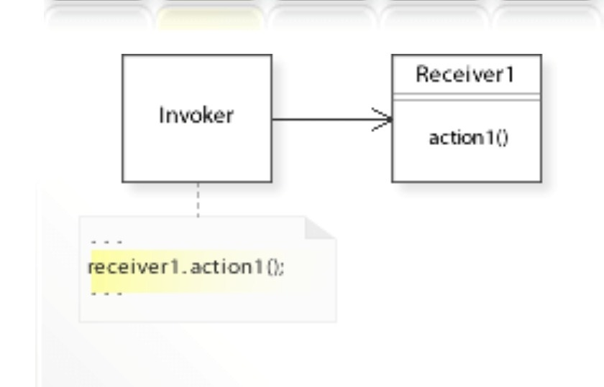
Problem:
Implementing (Hard-wiring) A Request Directly Into A Class Is Inflexible Because It Couples The Class To A Particular Request At Compile-time, Which Makes It Impossible To Specify A Request At Run-time.

Slide 5
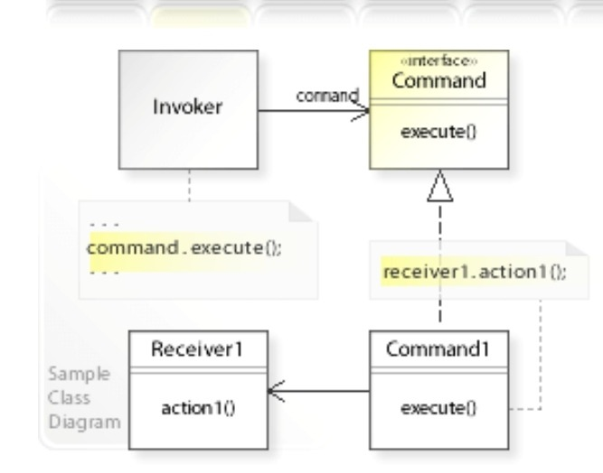
Solution:
Define Separate (Command) Objects That Encapsulate A Request.
A Class Delegates A Request To A Command Object Instead Of Implementing A Particular Request Directly.
This Enables One To Configure A Class With A Command Object That Is Used To Perform A Request. The Class Is No Longer Coupled To A Particular Request And Has No Knowledge (Is Independent) Of How The Request Is Carried Out.

Slide 6
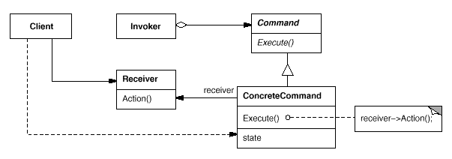
Structure Diagram

Slide 7
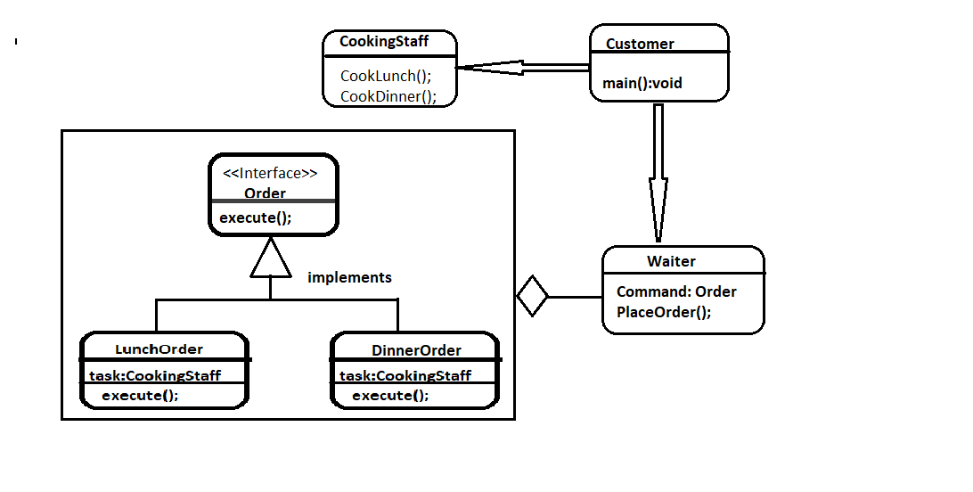
Class Diagram

Slide 8
Participants
Command (Order)
Declares An Interface For Executing An Operation
Concrete Command (LunchOrder , DinnerOrder)
It is a concrete implementation of the Command interface and defining an action will be performed.
Client (Customer)
Creates A Concrete Command Object And Sets Its Receiver
Invoker (Waiter)
It is a caller to invoke the request to carry the command object.
Receiver (CookingStaff)
It is simple handler method which perform the actual operation by Concrete Command.

Slide 9
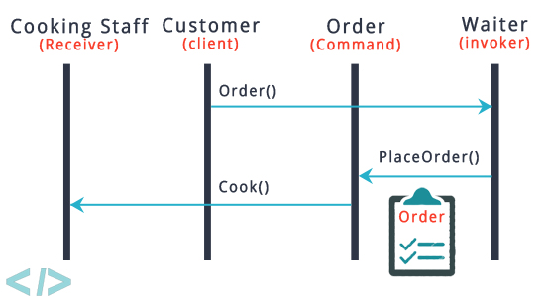
Collaboration
The Client Creates A Concrete Command Object And Specifies Its Receiver.
An Invoker Object Stores The Concrete Command Object.
The Invoker Issues A Request By Calling Execute( ) On The Command. When Commands Are Undoable, Concrete Command Stores State For Undoing Prior To Invoking Execute( ).
The Concrete Command Object Invokes Operations On Its Receiver To Carry Out The Request.

Slide 10
Consequences
Commands Are First-class Objects. They Can Be Manipulated And Extended Like Any Other Object.
Its Easy To Add New Commands, Because You Don’t Have To Change Existing Classes.
Commands Can Be Assembled Into A Composite Command.

Slide 11
Disadvantages
There Are A High Number Of Classes And Objects Working Together To Achieve A Goal. Application Developers Need To Be Careful Developing These Classes Correctly.
Every Individual Command Is A Concrete Command Class Which Will Be Difficult For Implementation And Maintenance.
Related Pattern:
Memento Design Pattern
Stratege Design pattern

Slide 12
Real World Examples
Graphic User Interface (GUI)
Macro Recording:.
Multi-step Undo
Networking
Application
Runnable interface (java.lang.Runnable)
Swing Action (javax.swing.Action) uses command pattern

Slide 13
Quiz
1. Which design pattern works on data and action taken based on data provided?
Command pattern
Singleton pattern
MVC pattern
Facade pattern
2 Command Pattern is also known as
kit
action
Invoker
Global Point
3 Give any Example of Command Pattern?
4.Command Pattern is in which Catelog
Structural Design Pattern
Behavioral Design Pattern
Creational Design Pattern
Other

Slide 14
5.Which Is the Correct List for work of Command pattern?
invoker,command,reciver,client
Command,invoker,reciver,client
Client,invoker,command,reciver
Client,command,invoker,reciver

